Slide 1


Sentiment & Emotion Analysis of COVID-19 Tweets
Group Members:
Jay Ganatra
Akshay Shirahatti
Bhavik Vasant Panchal
Manali Shah
Rahul Parande
Shruti Rao
Vanshika Patel Syracuse University

Slide 2

Introduction
The COVID-19 pandemic has had a profound impact on the world in many ways.
The coronavirus has affected millions of people and caused countless deaths. It has also disrupted economies, social structures, and daily life in ways that were unimaginable just a few years ago.
Sentiment and emotion analysis of social media data related to COVID-19 can be a valuable to understand the human impact of the pandemic.
By analyzing tweets, for example, we can gain insight into how people are feeling about the pandemic, what issues are most important to them, and how they are responding to news and information related to COVID-19.

Slide 3
Methodology
Defining the search criteria: Following keywords will be used to search for relevant tweets on Twitter.
Defining the sample size: The sample size is 1000 tweets. This number was chosen to ensure that we have a representative sample of tweets while still being manageable in terms of data processing.
Data collection: We used the Twitter API to collect tweets that match our search criteria. We will collect the full text of each tweet, the creation date, and any other relevant metadata.

Slide 4
Methodology
Data preprocessing: We preprocessed the collected data by removing URLs, mentions, hashtags, numbers, and special characters from the tweet text. We will also convert the text to lowercase, remove stopwords, and lemmatize the words. This will help to standardize the text and reduce noise in the data.
Sentiment analysis: We used the TextBlob library to perform sentiment analysis on the preprocessed tweets. This will allow us to determine the overall polarity and subjectivity of each tweet.

Slide 5
Methodology
Emotion analysis: We used the BERT Transformers library to perform emotion analysis on the preprocessed tweets, allowing us to determine the predominant emotion expressed in each tweet.
Data visualization: We used matplotlib to create visualizations to communicate our findings of the sentiment and emotion analysis results clearly and concisely.
Data interpretation: We interpreted the results of the analysis and draw conclusions about people's emotions and sentiments related to the COVID-19 pandemic on Twitter. We will also identify any limitations or biases in the data and discuss implications for future research.

Slide 6
Realtime Results using DistilRoBERTa
DistilRoBERTa-base is a pre-trained language model that can be fine-tuned for various NLP tasks, including emotional analysis.
Using the model, we predict emotions on new COVID-related data, in form of tweets. We classify the tweets into:
ANGER, DISGUST, FEAR, JOY, NEUTRAL, SADNESS, SURPRISE
The predicted emotions can be analyzed to gain insights into people's thoughts and feelings about the pandemic and can be used to inform decision-making and communication strategies.

Slide 7
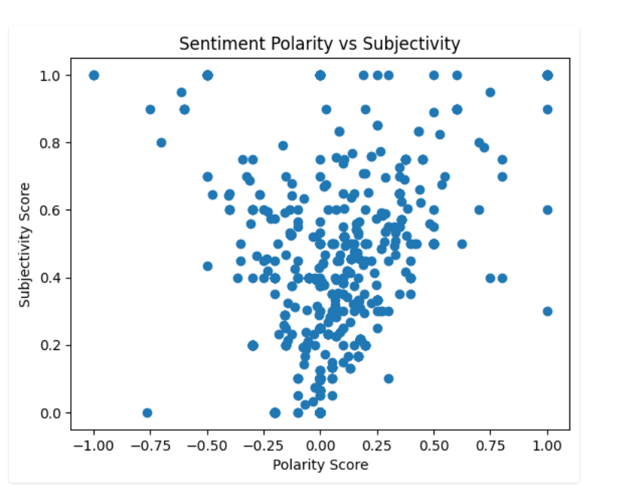
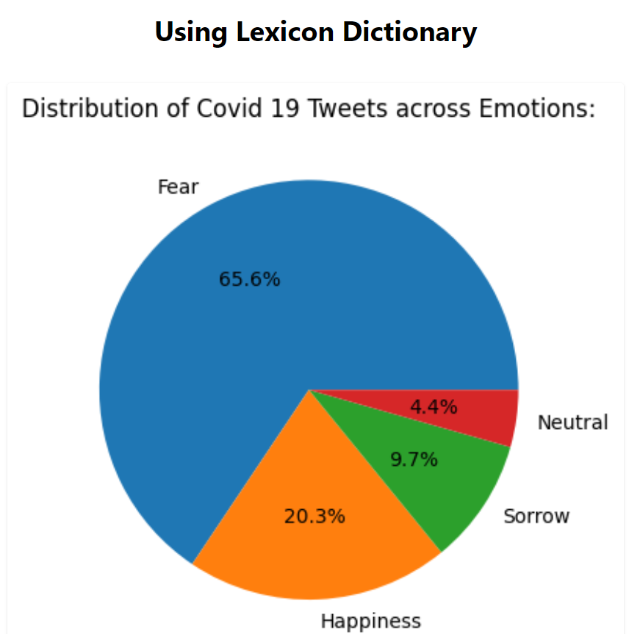
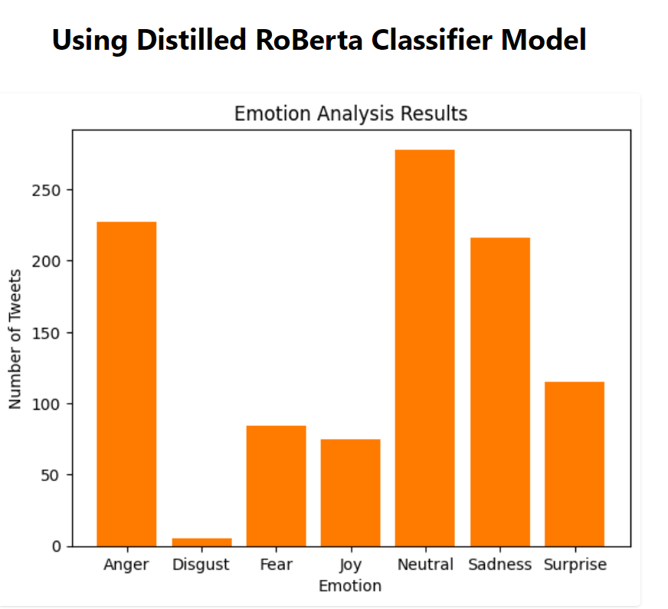
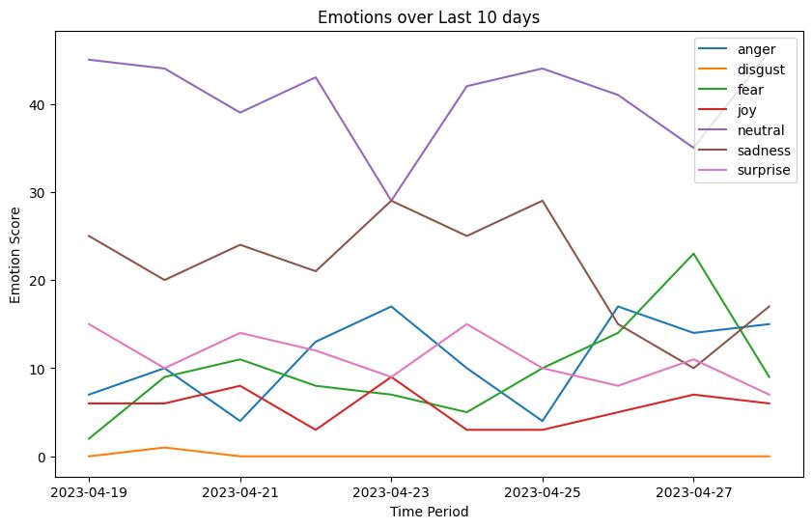
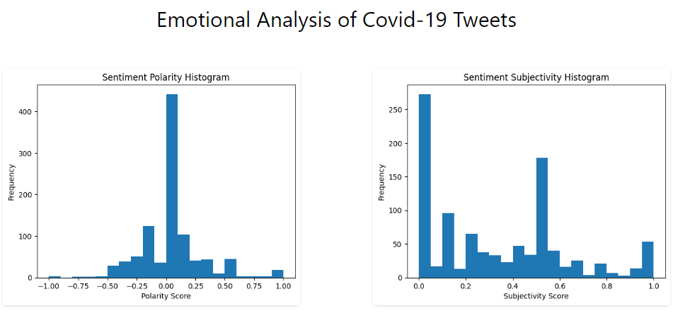

Slide 8
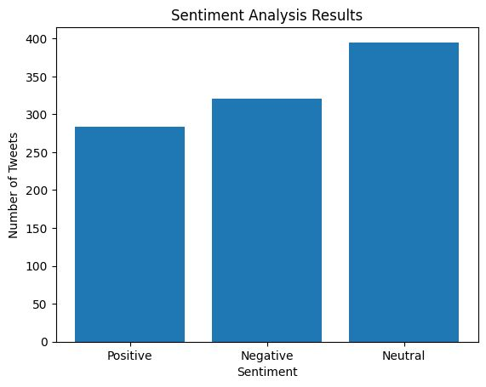
Conclusion
Sentiment analysis:
The sentiment analysis results show that out of the 1000 tweets collected, the majority (39%) were classified as neutral, with 28% classified as positive and 33% classified as negative. This suggests that, overall, there is no overwhelmingly positive or negative sentiment towards the topic of COVID-19 on Twitter
Emotion analysis:
The emotion analysis results show that the dominant emotions expressed in the tweets were neutral (39%) and least expressed was disgust (0.4%). This is consistent with the sentiment analysis results, as a neutral sentiment implies a lack of strong emotion. The prevalence of fear in the tweets suggests that COVID-19 is still a topic of concern and uncertainty for many people.

Slide 9
3. Polarity and subjectivity analysis:
The polarity analysis shows that the majority of tweets had a neutral sentiment (39%). This suggests that, on average, people are expressing a relatively balanced view towards the topic of COVID-19 on Twitter. The subjectivity analysis shows that the majority of tweets were objective (70%) rather than subjective (30%), indicating that people are sharing factual information rather than personal opinions.
Overall, the results of the analysis suggest that while COVID-19 remains a topic of concern for many people, there is a relatively balanced and objective discussion around the topic on Twitter. This is important for understanding public perceptions and attitudes towards COVID-19, and can be used to inform communication and public health strategies.

Slide 10
THANK YOU

